Slide 1
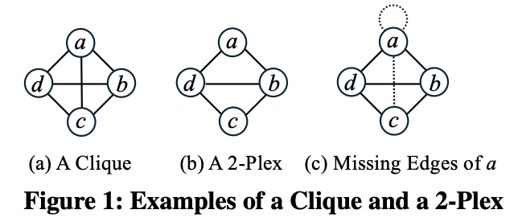
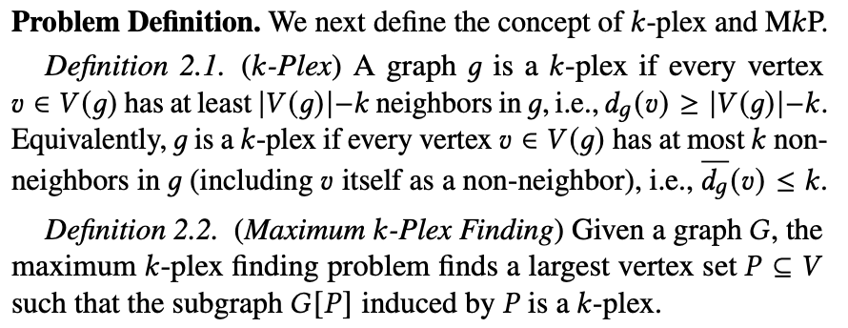
k-Plex
v₁₅
Maximum 2-plex
v₈
v₃
v₉
v₂
v₁₃
v₁₄
v₄
A graph $G=(V, E)$is a k-plex if each vertex have at least $|V|−k$ degree
v₇
v₁
v₁₀
v₅
v₁₁
v₁₂
v₆

Slide 2
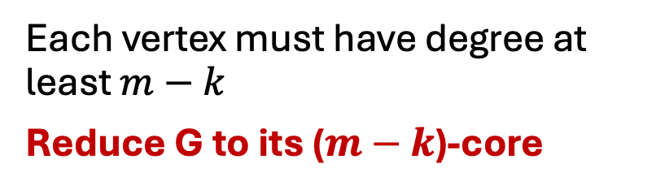
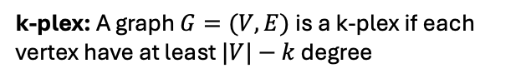
Degree Pruning
k-plex: A graph $G=(V, E)$is a k-plex if each vertex have at least $|V|−k$ degree
To find a k-plex of size at least $m$:
Remove if finding a 2-plex of size 5
Each vertex must have degree at least $m−k$
Reduce G to its ($m−k$)-core
v₁₅
v₈
v₃
v₉
v₂
v₁₃
v₁₄
v₄
v₇
v₁
v₁₀
v₅
v₁₁
v₁₂
v₆

Slide 3
Upper bound
Upper bound of k-plex is core(G)+k
Proof by contradiction:
Assume there exist a k-plex larger than core(G)+k i.e :
|P| > core(G)+k, then every vertex in P must have degree > core(G)+k-k. So P can exist in a core larger than core(G), which a contradiction

Slide 4
k-core and Degeneracy Order
k-core: Largest induced subgraph with minimum degree = k
Degeneracy Order
Notes:
K-core of a graph is defined as largest induced subgraph with minimum degree equals to k. For example in the this graph entire of the graph is 1-core, because every vertex have at least degree = 1
2-core of the graph is an induced subgraph where each vertex have at least degree 2. yellow and red vertices are comprised of 2-core of the graph.
3-core of the graph is shown in red where each vertex have at least degree 3.
K-core decomposition is a problem to find core number of every vertex, that is the largest value of k that v belongs to a k-core.
All the green vertices shown in the graph have core number 1,
yellow vertices have core number 2,
and red vertices have core number 3.
There are many applications of k-core decomposition, including community detection, detecting protein interactions etc.

Slide 5
Preprocessing and Residual Graph
Original graph
Varies with every k!
Graph after shrinking

Slide 6
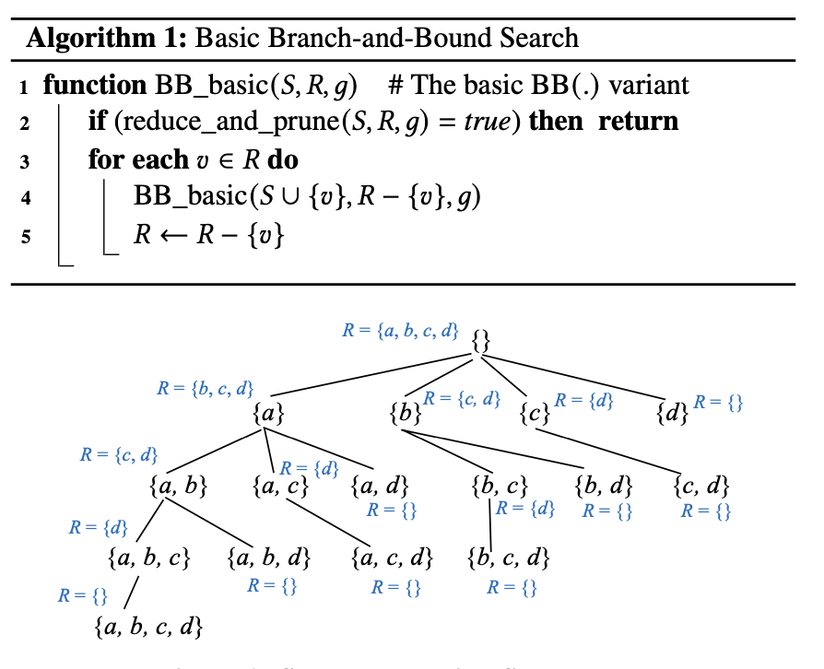

Slide 7
ML for k-Plex
k values: 2, 3, 4, 5, 6, 7, 8, 9, 10, 15, 20
Include R branching

Slide 8
Features
No. of vertices and edges
Average degree
Maximum degree
No. of vertices and edges, max degree, avg degree in residual graph
k-truss
k-core – core-number, no. of vertices in each level (k levels)
Value of k

Slide 9
Definitions
n = number of vertices
m = number of edges
d_avg = average degree
d_max = maximum degree of the graph
max_core = core number of the graph
Core sizes
Solutions:
UMKP = our UMKP solution
AltRB = UMKP integration with AltRB
kPEX = kPEX solution by Cheng Long
Pivot_Br = kPEX with pivot branching method
S_Br = kPEX with S branching method

Slide 10
Zipf’s distribution
Poisson distribution
Kurtosis

Slide 11
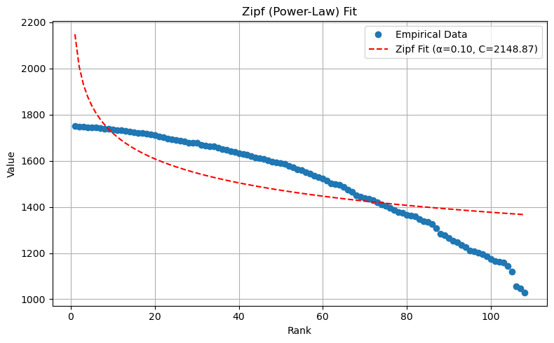
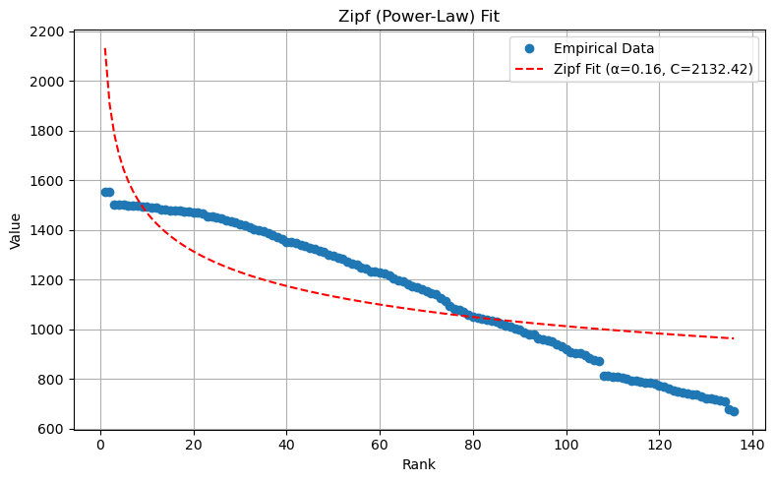
K-core Spectrums– Zipf’s Fit
Sequential model to be used.
Prepare data (kore number, size of core)

Slide 12
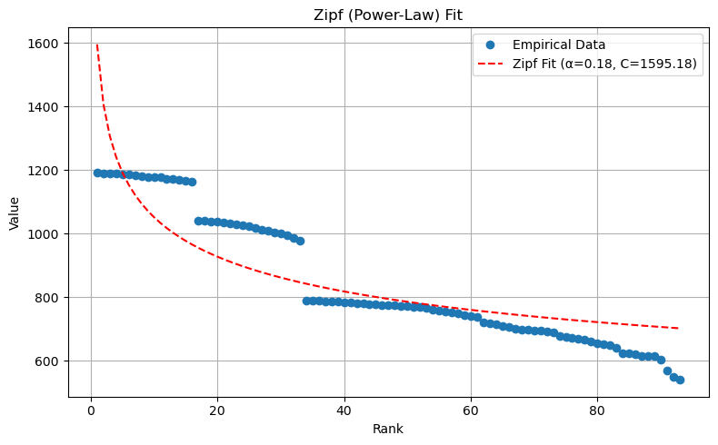
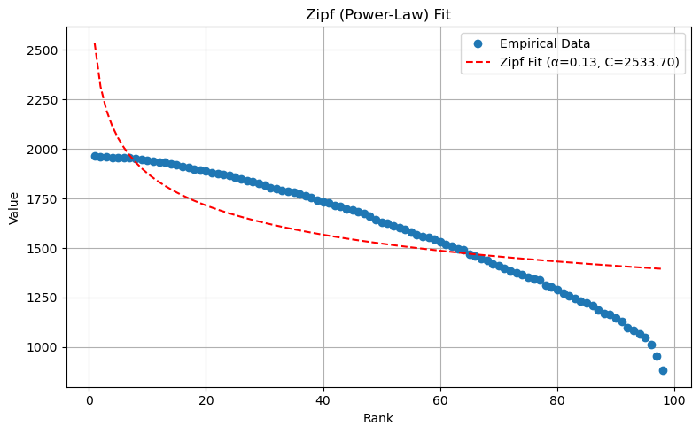
K-core Spectrums– Zipf’s Fit

Slide 13
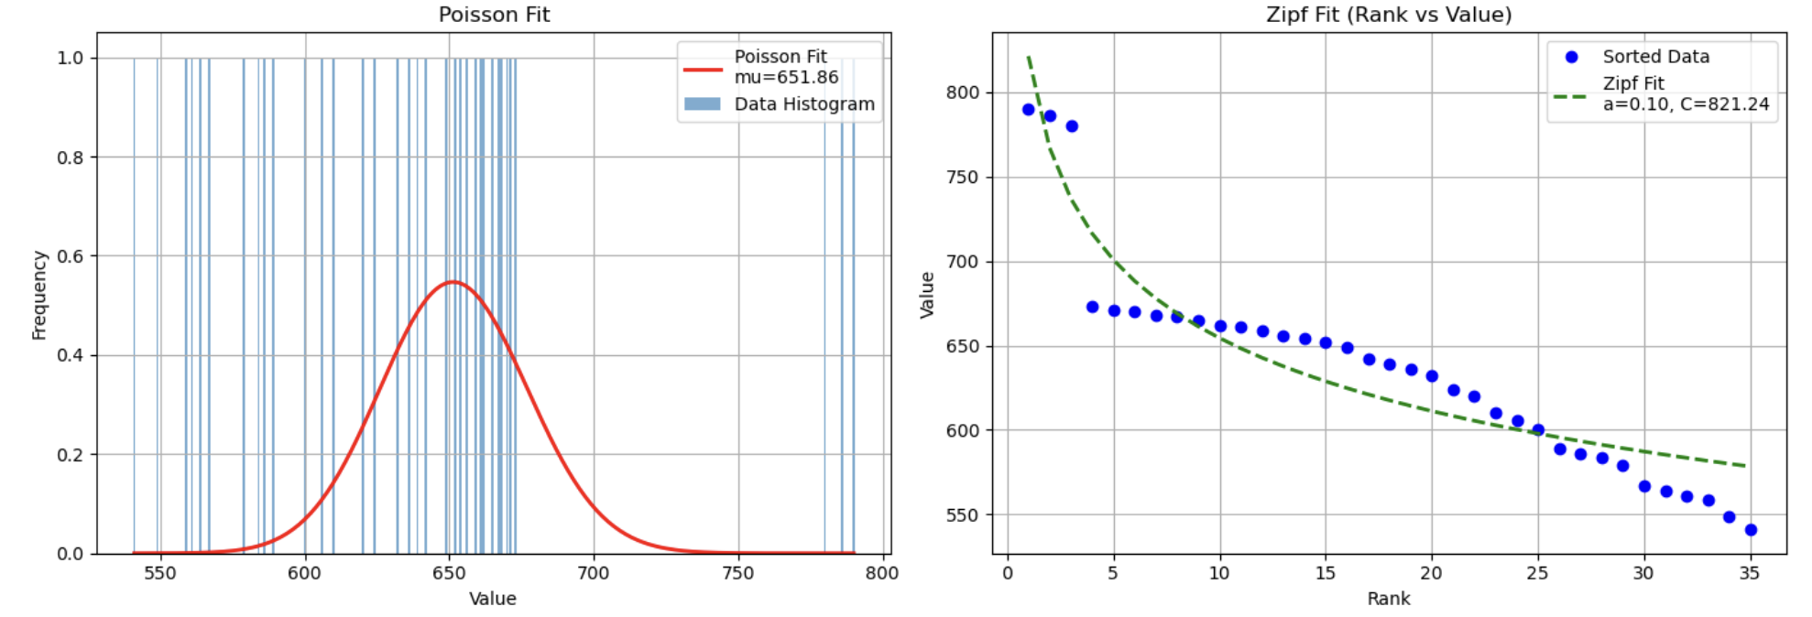
Poisson distribution fit
Poisson fit is not a good choice, data is descending and have smaller variance

